Slide 1
How to create a Slack Bot

Slide 2
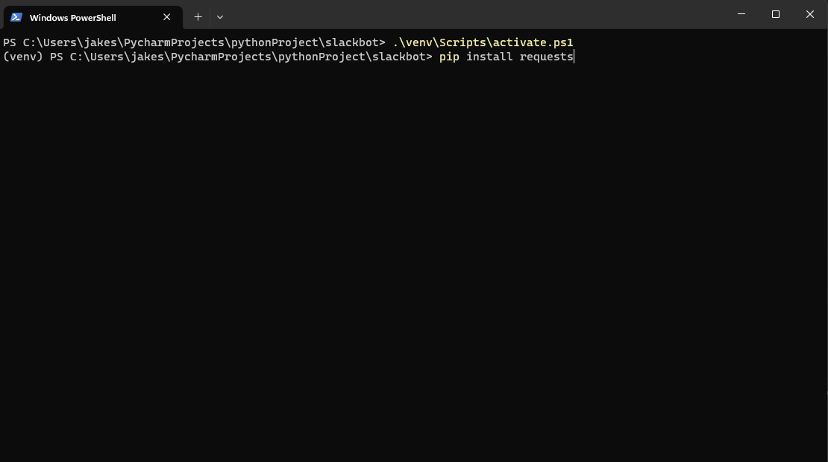
Install requests in python

Slide 3
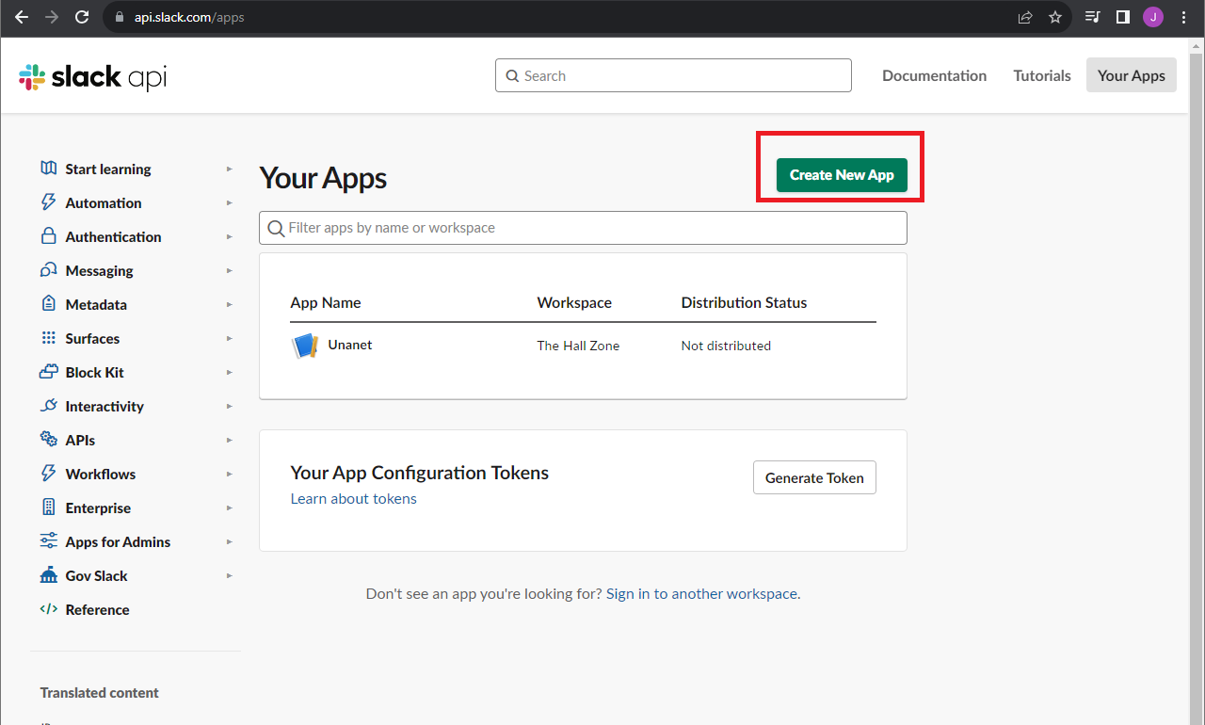
Create App

Slide 4
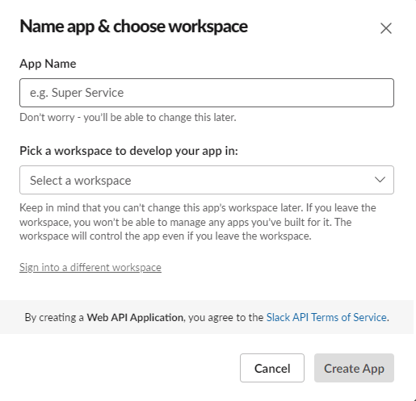
Give App a Name

Slide 5
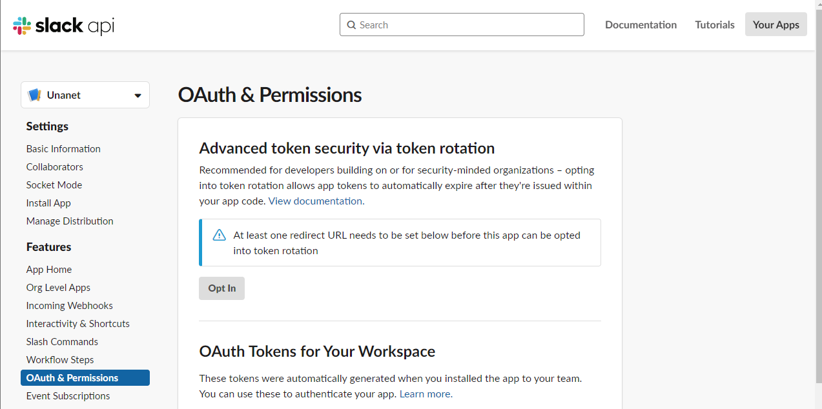
Go to Oauth & Permissions

Slide 6
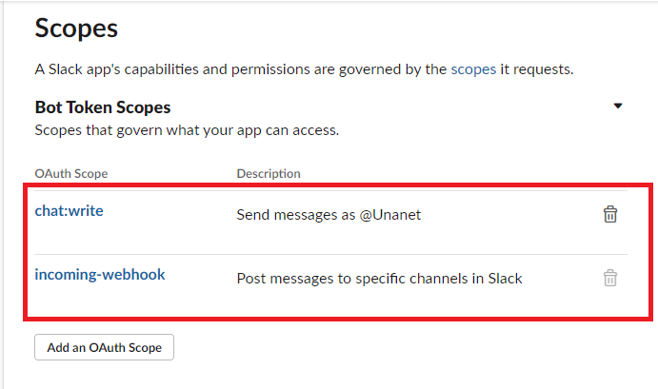
Give App Privileges

Slide 7
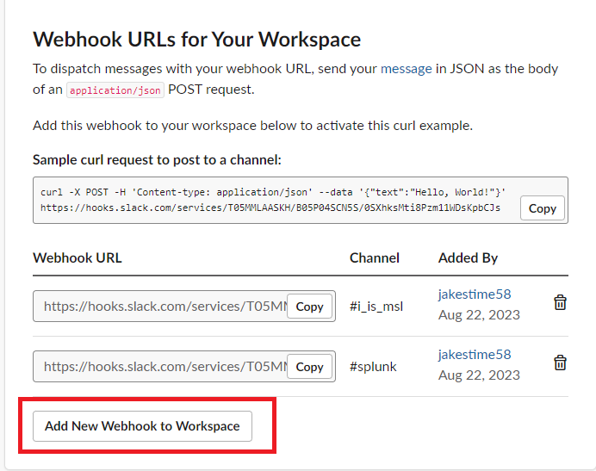
Generate Webhook

Slide 8
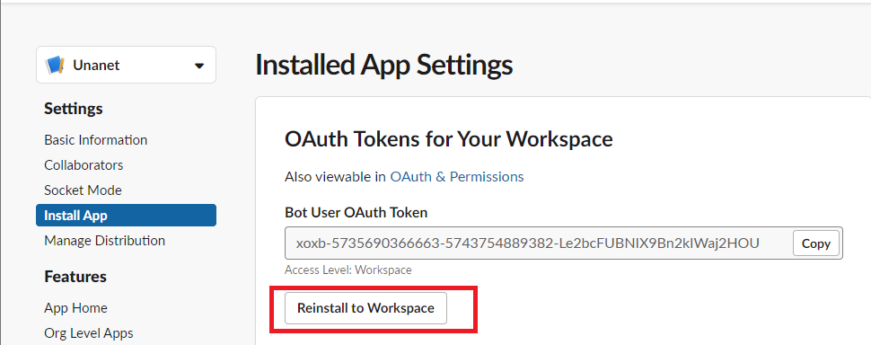
Install App to Workspace

Slide 9
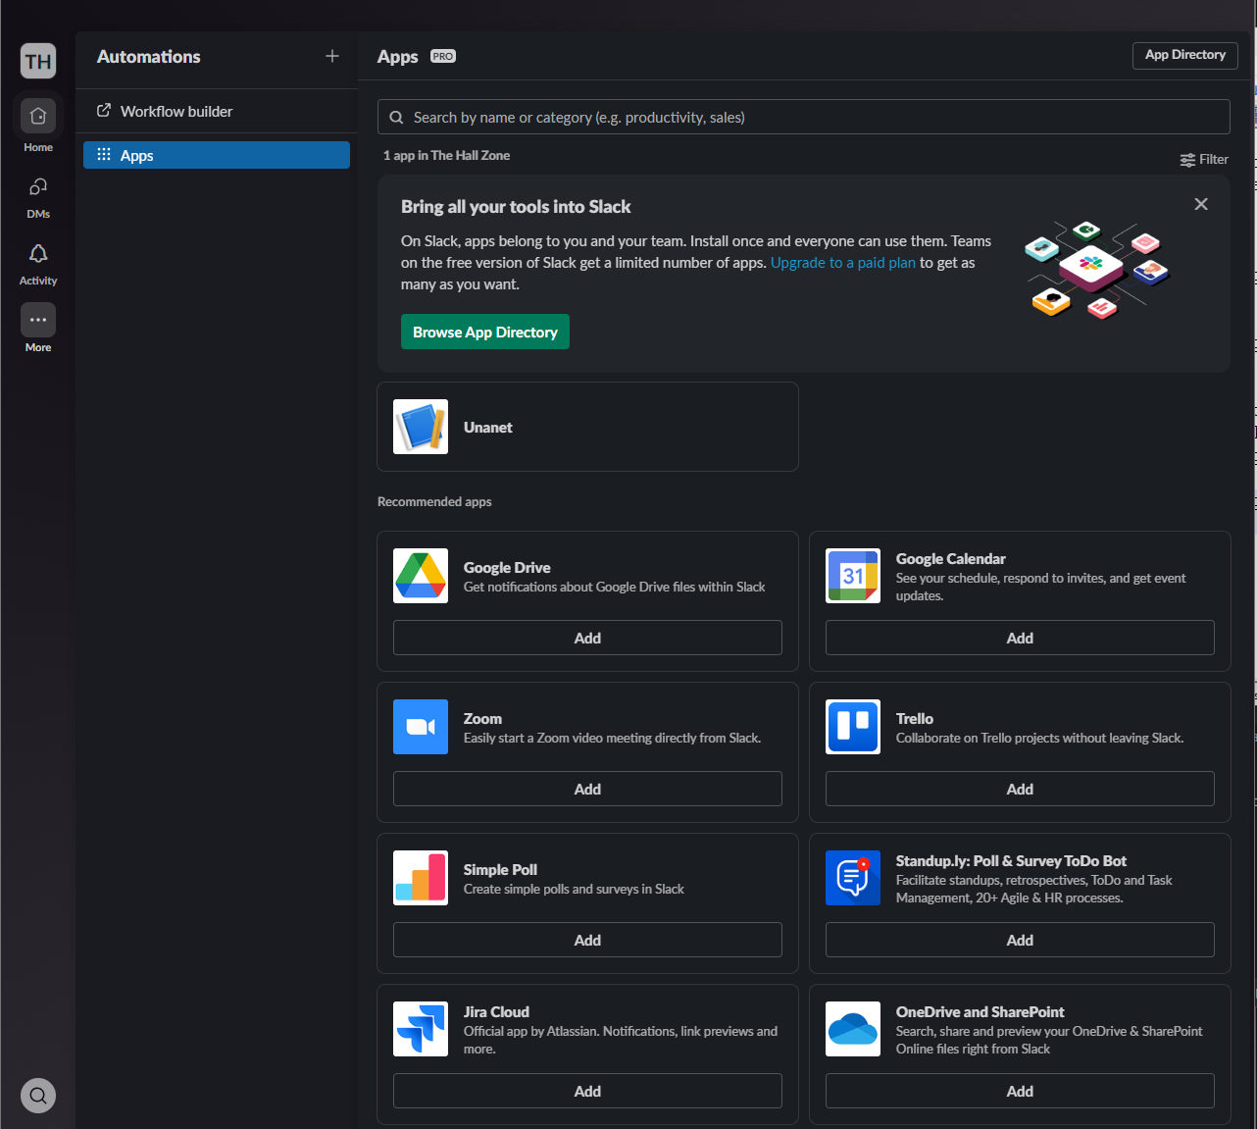
Search for App

Slide 10
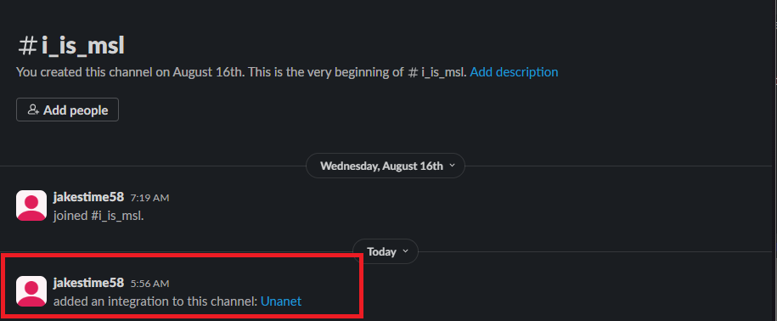
Verify App has been added to Channel

Slide 11
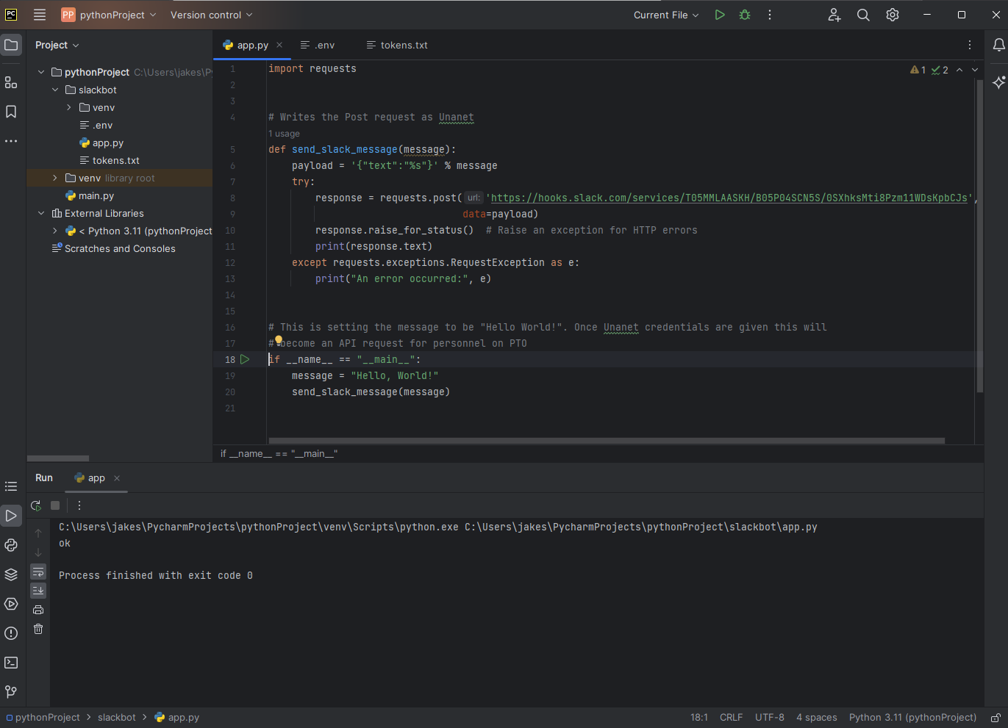
Write Python Script

Slide 12

Run Script

Slide 13
Next Steps
Receive Unanet Credentials
Add a cron job to run script every morning to add to the msl chat who is on PTO on the current day.

